Slide 1
HPC QMUL & LINUX TUTORIAL
MSc Cancer Genomics and Data Science
Ankit Patel

Slide 2
Overview
QMUL HPC (apocrita)
Create account
Log in
Termius
File transfer
Submitting jobs
Ondemand – Rstudio
Ondemand – jupyter notebook
Linux
Useful bash commands
Vim commands
Extra resources

Slide 3
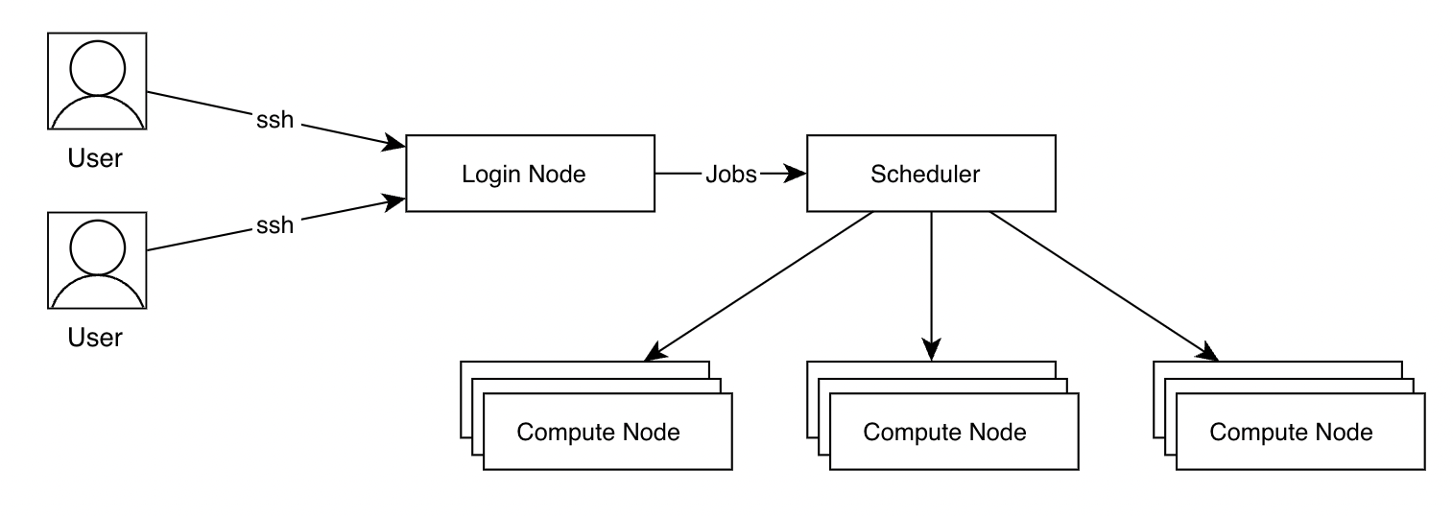
QMUL HPC -APocrita
https://docs.hpc.qmul.ac.uk
• Apocrita: A heterogeneous HPC cluster managed by ITS Research at Queen Mary University of London (QMUL)
• Comprises around 300 nodes and 13,500 cores
• Located in the Virtus shared data centre in Slough
• Primarily supports QMUL researchers and is owned by QMUL
Why Use Apocrita?
• Data volume: substantial processing power for large datasets
• Speed and Efficiency: HPC clusters use parallel processing, which splits tasks into smaller chunks that run simultaneously
• Scalability and Cost-effectiveness
• Access to Specialized Hardware: GPUs for ML etc

Slide 4
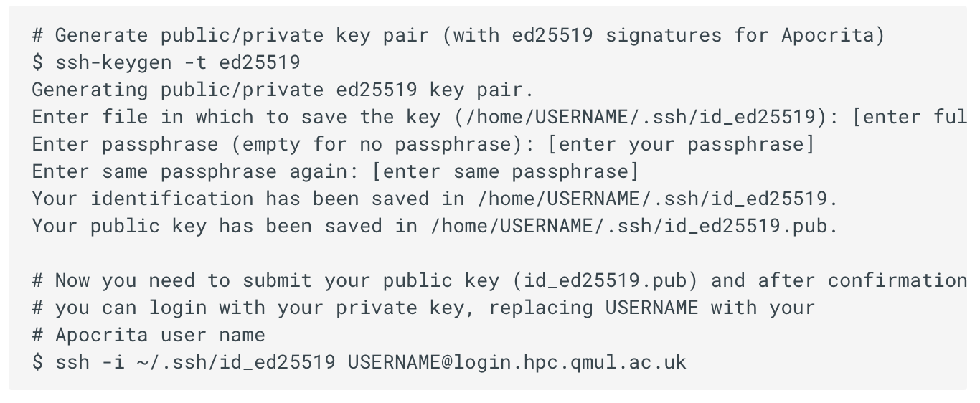
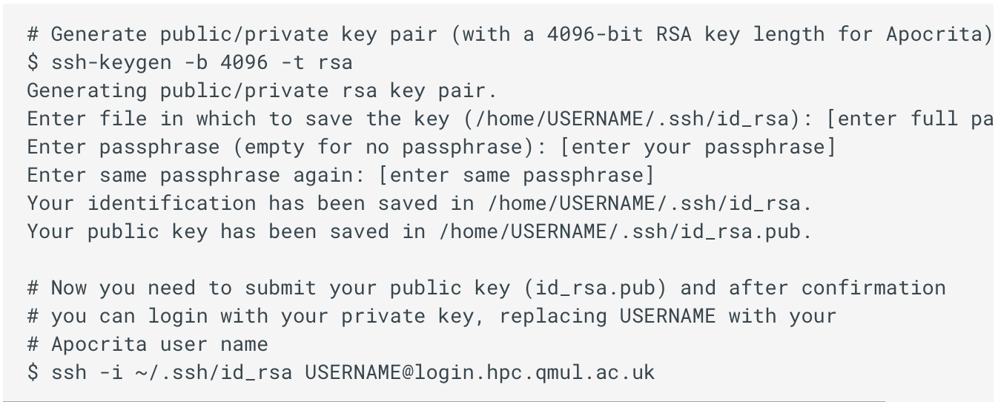

Generate ssh key
Open a terminal/command prompt and execute the ssh-keygen command

Slide 5


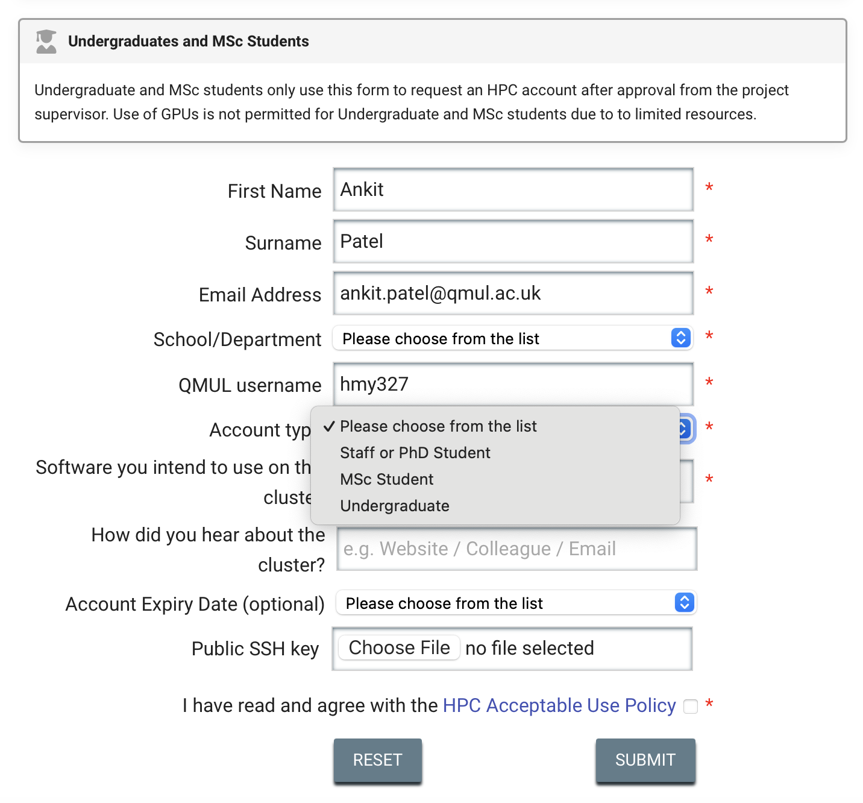
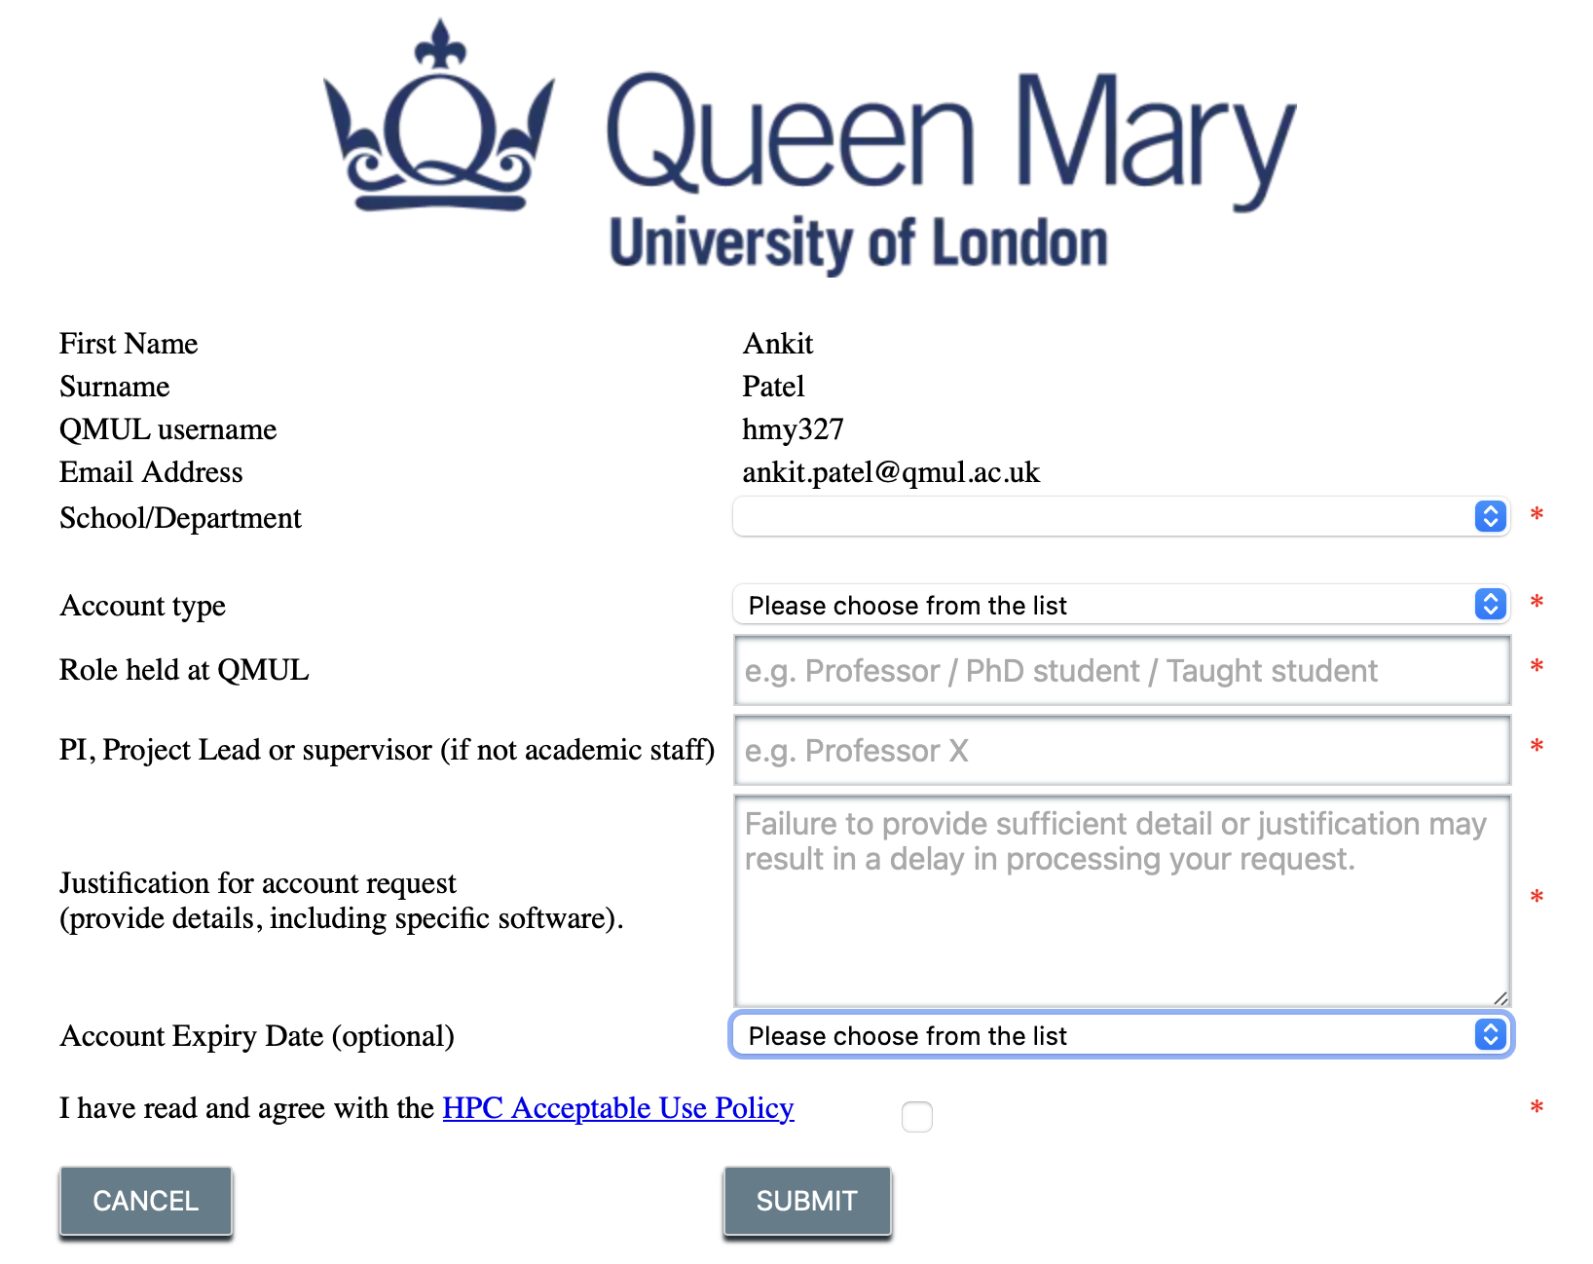
submit your public key
After your key has been verified and copied into place, you will receive a confirmation email.

Slide 6
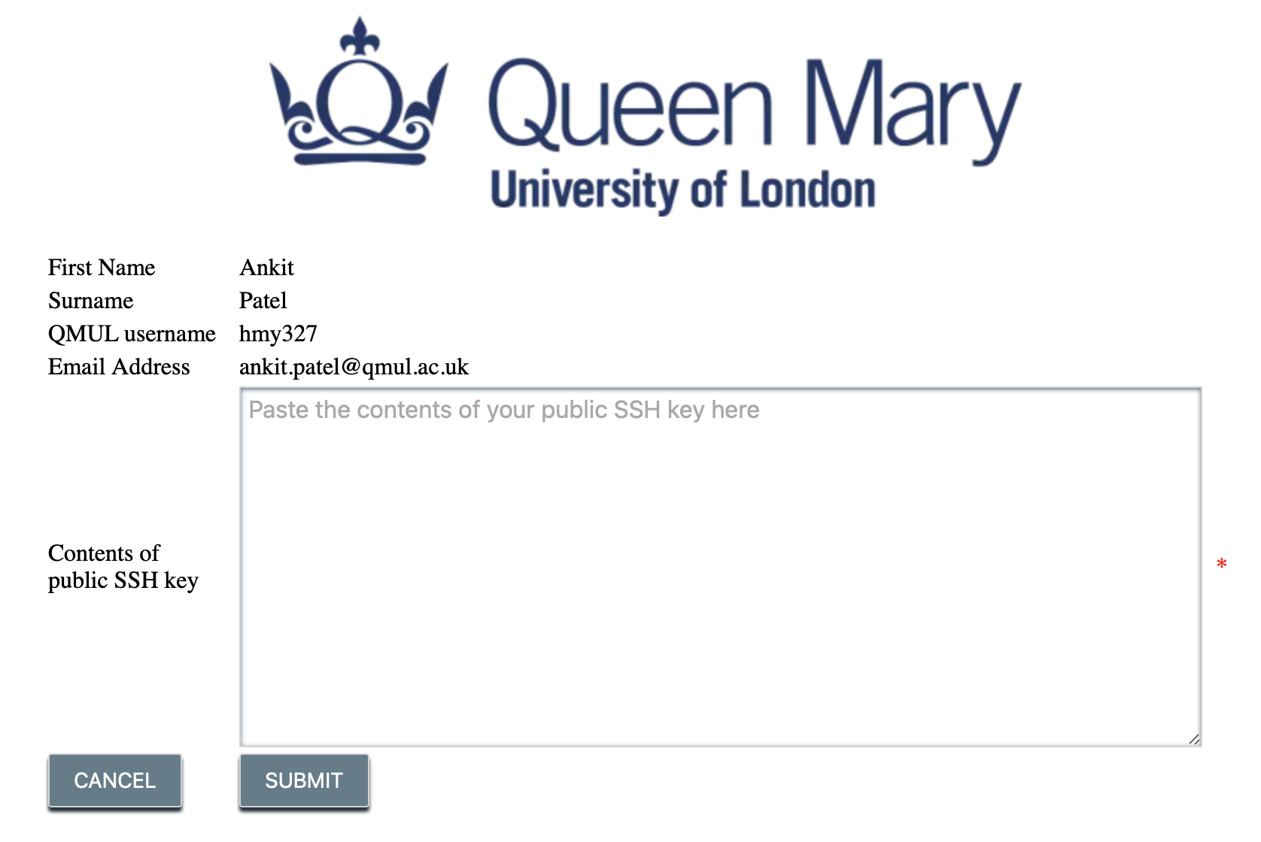
submit your public key for another machine
After your key has been verified and copied into place, you will receive a confirmation email.

Slide 7
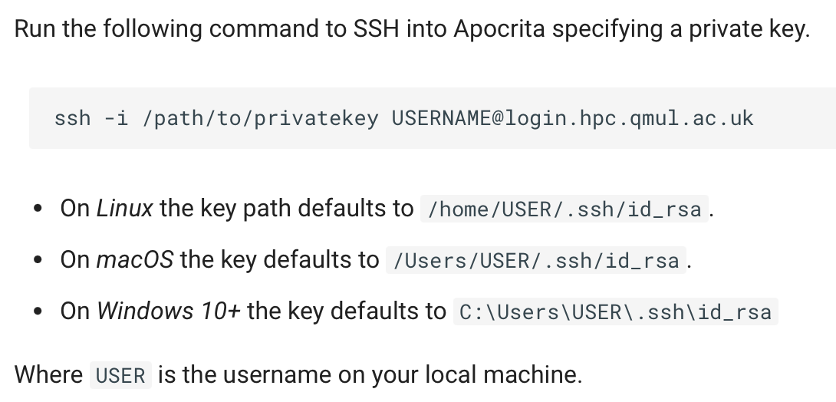
Logging in
SSH access via the Terminal
To login into Apocrita using your password and SSH key, use one of the following methods
(valid for all Linux, macOS and Windows 10+ systems)
SSH connection with a specific key

Slide 8
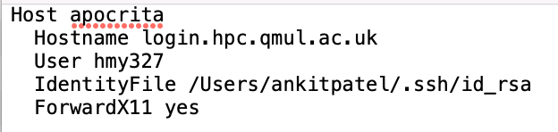
Logging in
Create an SSH configuration file
- create “config” text file and copy to .ssh folder
Add the key to your SSH agent
- Termius for mac/windows/Linux (recommended)
- MobaXterm for windows

Slide 9
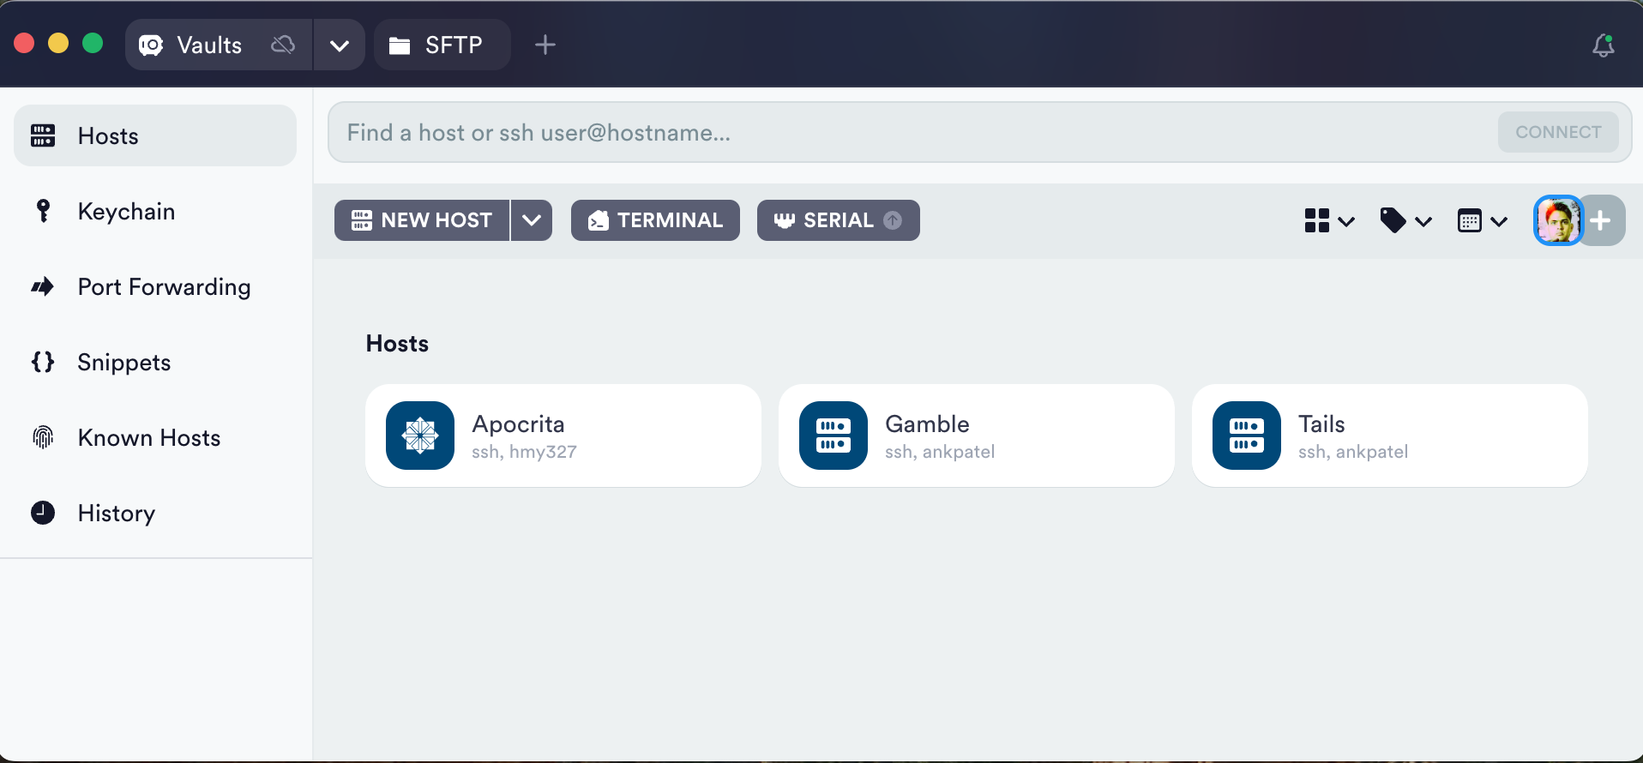
Logging in - Termius
Download Termius
https://termius.com/download/macos
https://termius.com/download/windows
https://termius.com/download/linux

Slide 10

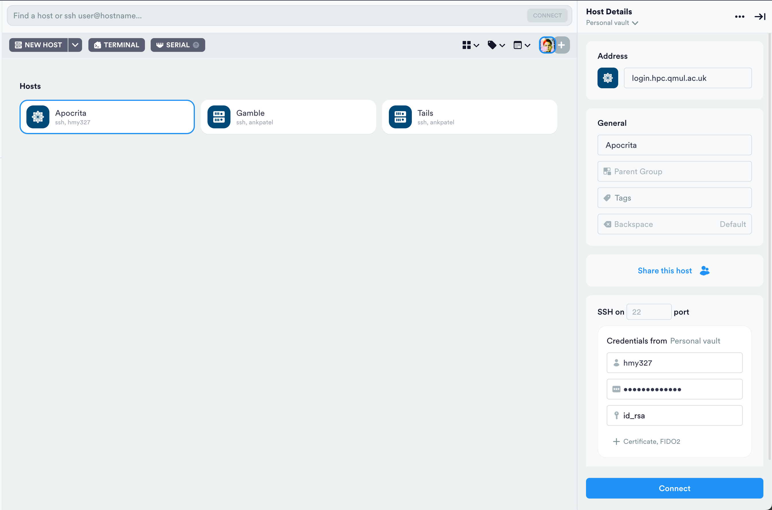
Logging in - Termius
This is your private key file generated into .ssh folder
First Import this via Keychain > SSH ( from the left column options)
Provide passphrase if you have one

Slide 11
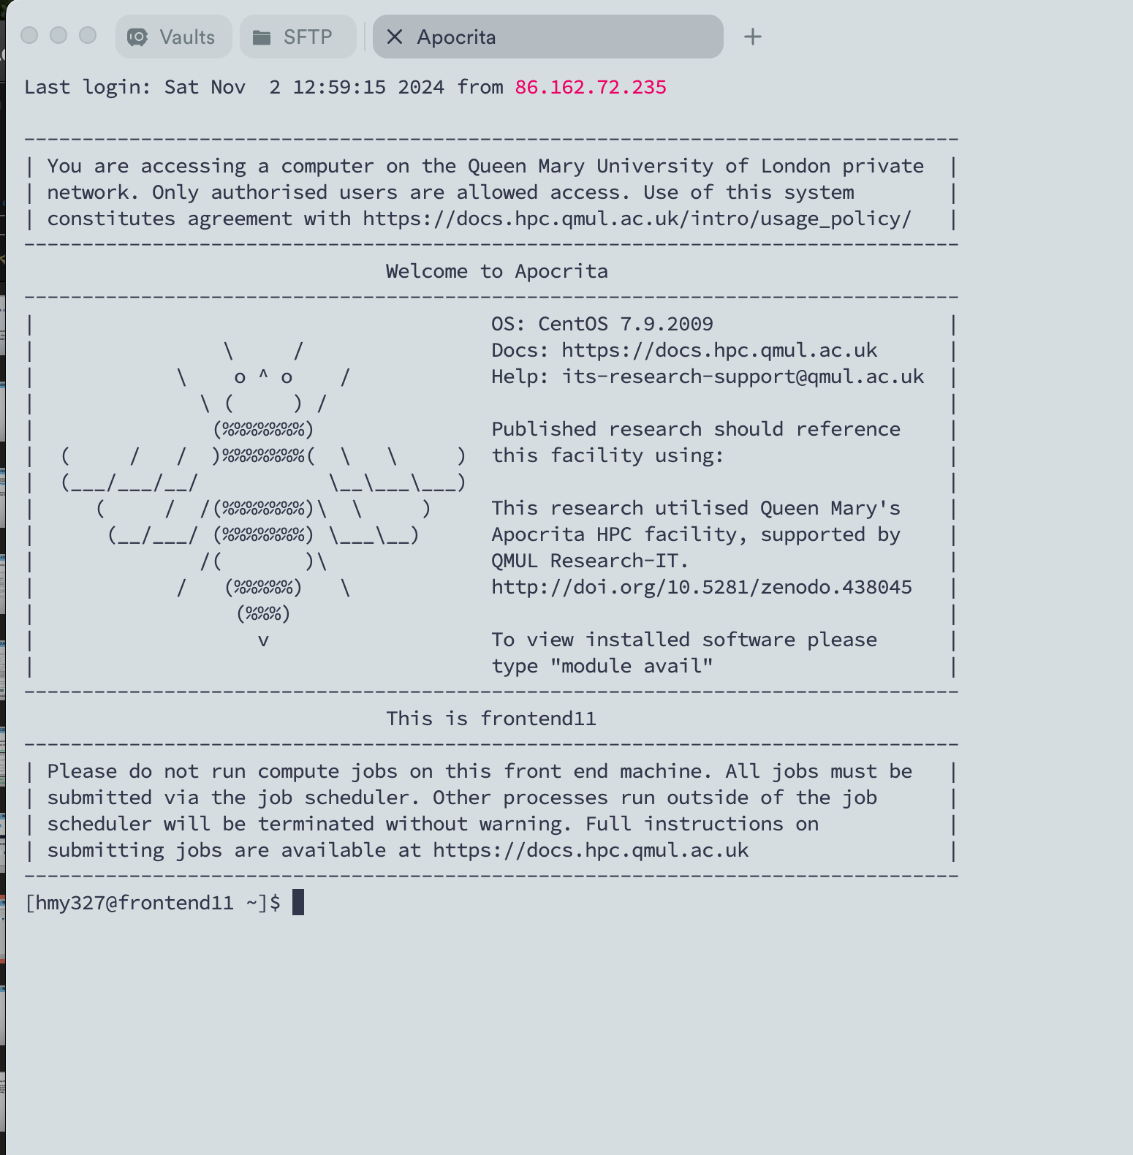
Logging in - Termius

Slide 12
FILE TRANSFER
Upload / download file from HPC
https://docs.hpc.qmul.ac.uk/storage/movingdata/
Secure File Transfer Protocols (SFTP): GUI – FileZilla, MobaXterm,
Use scratch space (~3TB storage available)
Scratch is held in /data/scratch/hmy123 and is automatically deleted 35 days after the last modification time.
Termius

Slide 13
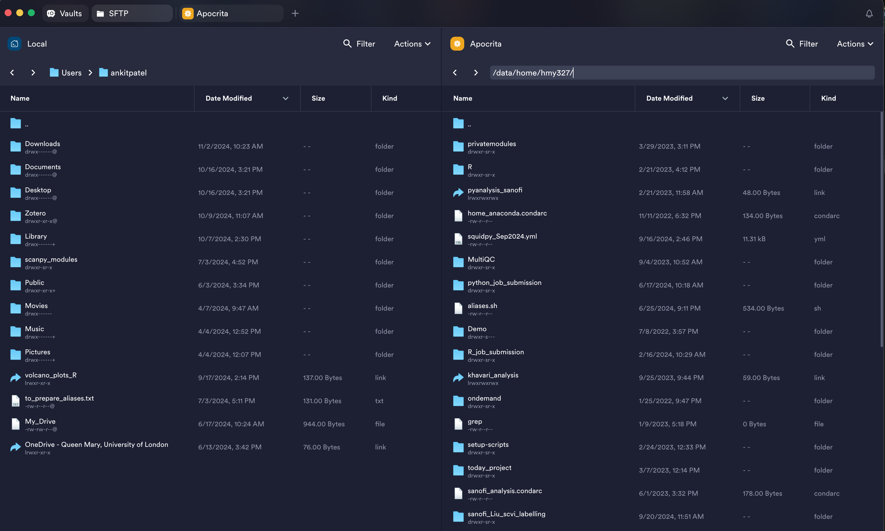
File transfer - Termius

Slide 14
Maintaining your authorized_keys file on Apocrita
The authorized_keys file in the /data/scratch/hmy123/.ssh folder on Apocrita contains a list of the public keys that will allow a user to authenticate into their account, by providing the corresponding private key.

Slide 15
Running interactive session on Apocrita
qlogin -pe smp 1 -l h_vmem=4G -l h_rt=1:0:0
core required
time required
memory required

Slide 16
Submit jobs
(https://docs.hpc.qmul.ac.uk/using/)
Common commands to submit / manipulate jobs:
(https://docs.hpc.qmul.ac.uk/cheatsheets/)
qsub > to submit job
qstat > to check status
qdel > to delete job
qhold > holds a job from running
qrls > releases a job from a held status
Jobstats > to check the usage of last completed 25 jobs
Commands specific to apocrita
qmquota > storage information
module avail > to check all installed modules/packages on server
Build Job scripts : Job scripts builder : https://docs.hpc.qmul.ac.uk/using/jobscriptbuilder/
Writing your job scripts with a text editor :
vim
emacs
nano (module load nano)

Slide 17
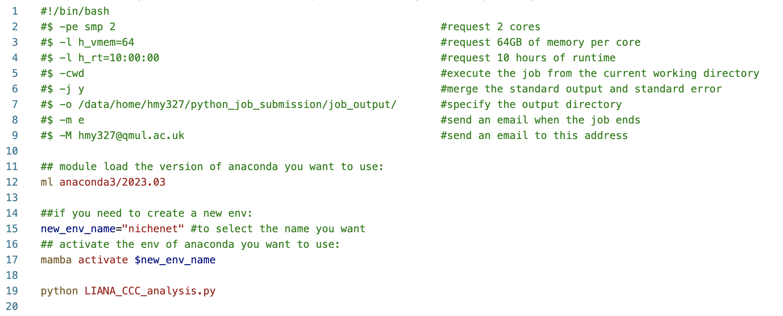
Submit jobs
Example of python job

Slide 18
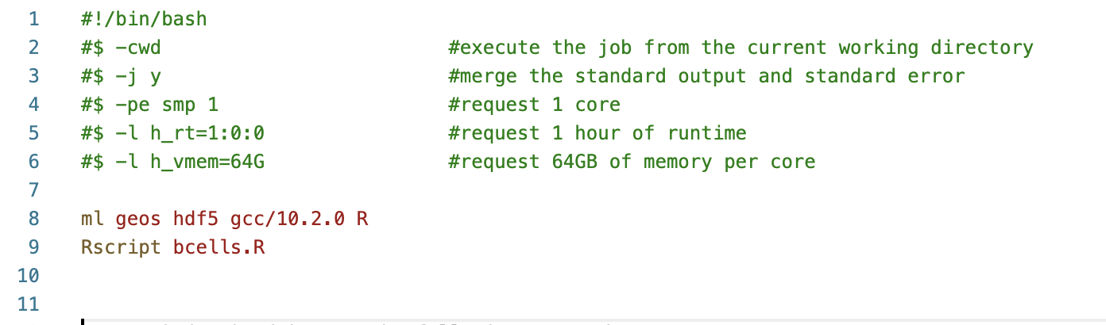
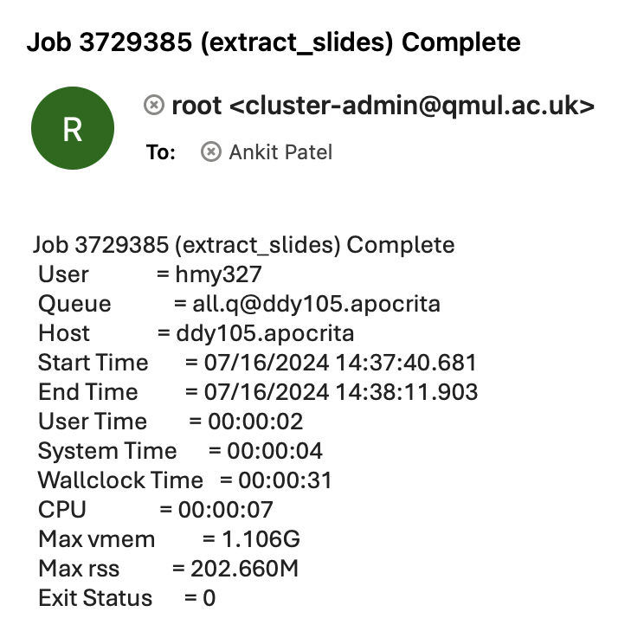
Submit jobs
Example of R script job
System email once the job either terminated / finished /ran out of memory
#virtual memory allocated
#real memory used

Slide 19
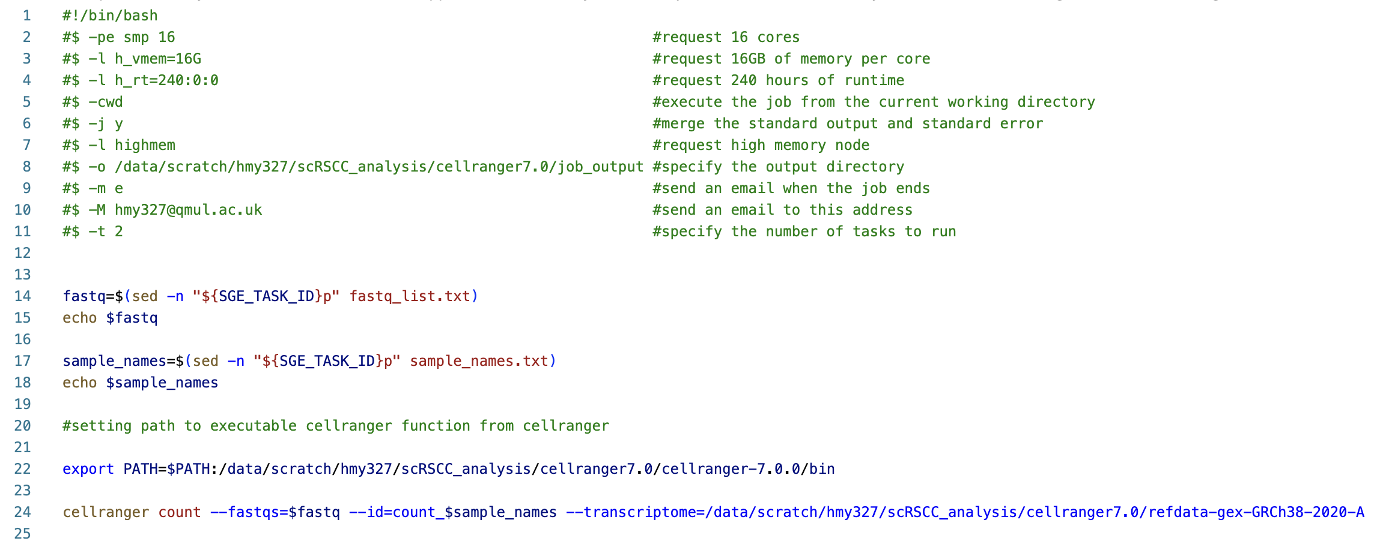
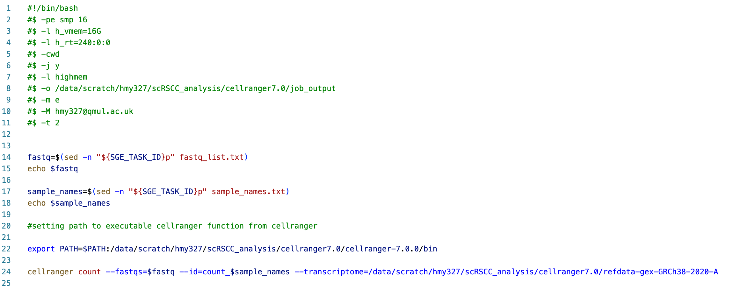
Submit jobs
Example of array job

Slide 20
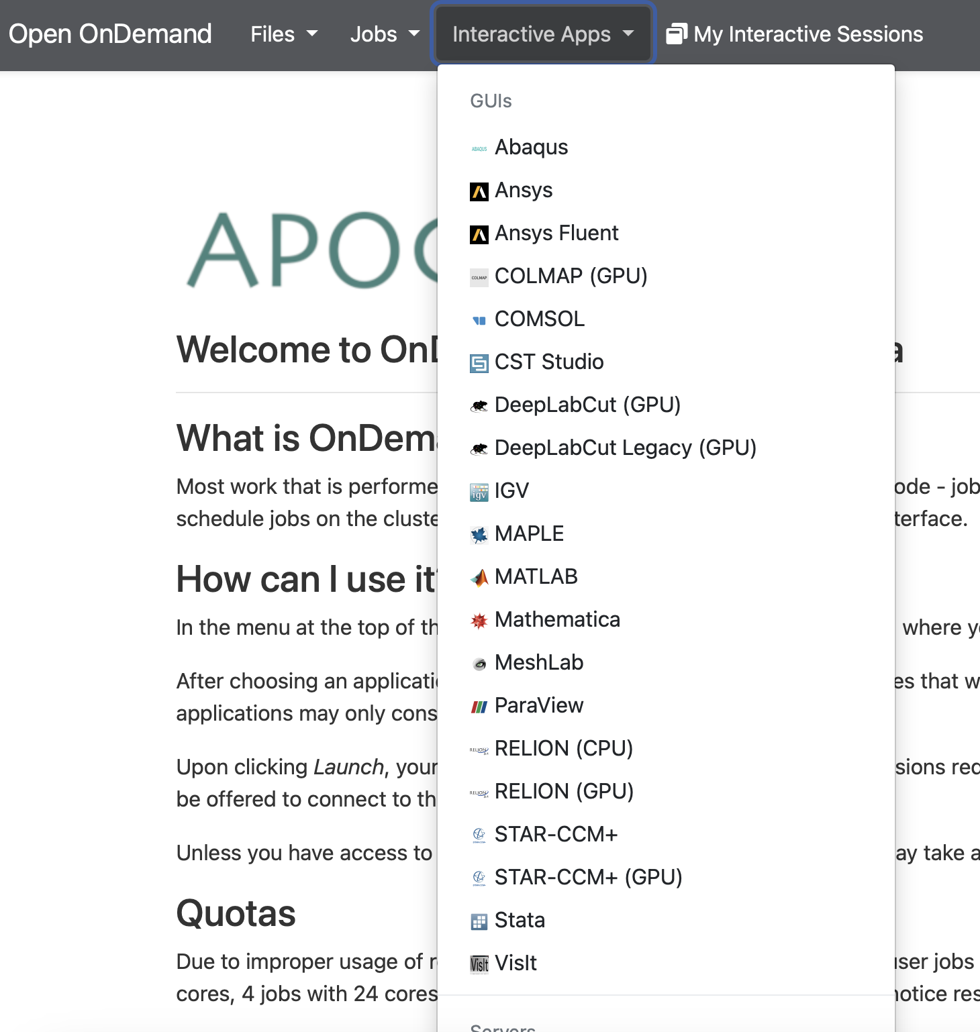
ONDEMAND
https://ondemand.hpc.qmul.ac.uk

Slide 21
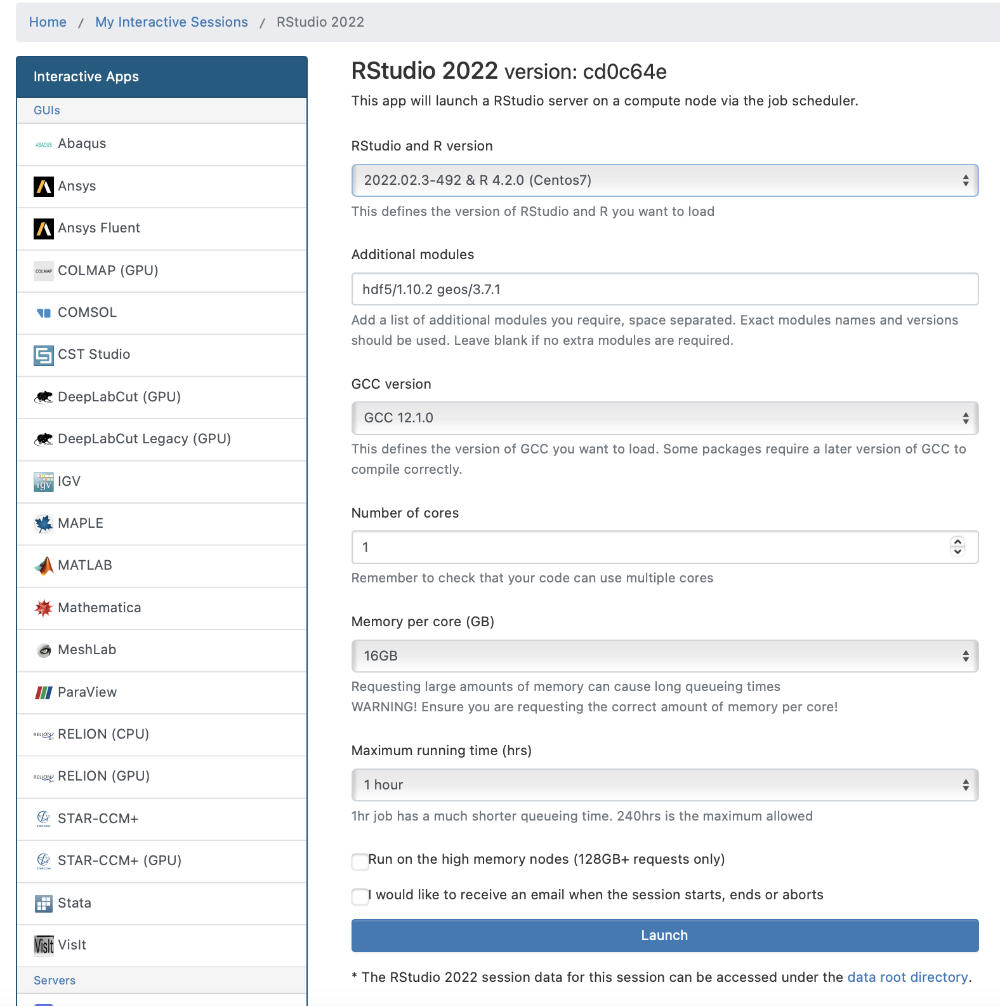
ONDEMAND - RSTUDIO
RStudio 2022
Load additional required module
* Your installed R packages in one session will be available for the next session. Packages are installed in your HPC home directory ./R folder
Select compiler version
Unless your package supports parallel processing, request 1 core only
For more information
https://docs.hpc.qmul.ac.uk/ondemand/rstudio/

Slide 22
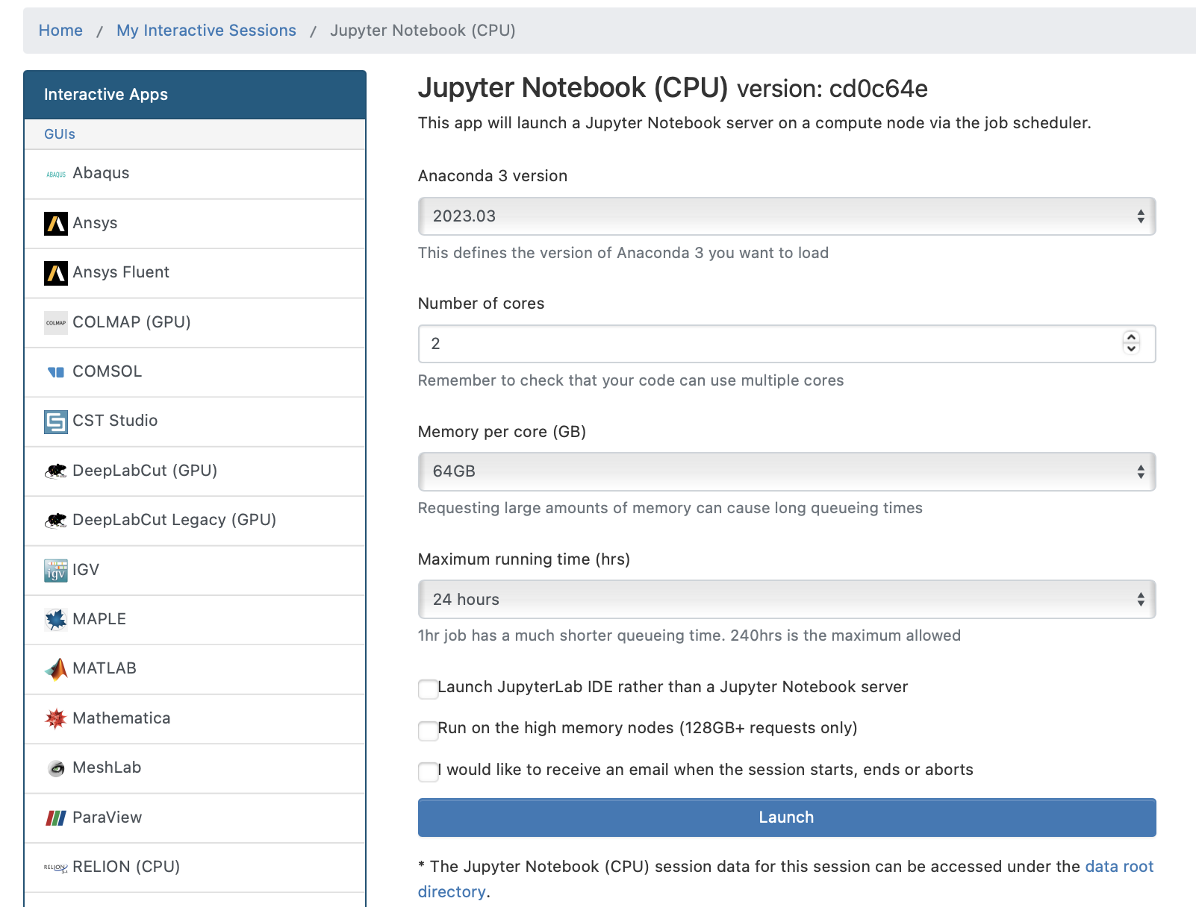
ONDEMAND – Jupyter notebook
Jupyter Notebook (CPU)
Choose the same anaconda version as your conda environment version
For more information
https://docs.hpc.qmul.ac.uk/ondemand/jupyter/

Slide 23
LINUX
Common Linux commands
cd (cd .. & cd -), ls, cp, mv, mkdir, pwd, cat, touch, rmdir, rm
du -h > file size
du –sh * > size information for all files and folders
ls -al >list all files with dates and writing permission
ls -l | wc -l >list total number of files
Vim commands
vim file.name.sh
shift + I > insert text
esc > quit editing mode
:w >to save changes
:q > to close the file
:q! > close file without saving changes
:x > save and close file
:wq > save and close file
Notes:
The Shebang (#!)
#!/bin/bash
formatting for the shebang was important (ie no spaces, must be on first line)
Bash accomodates piping and redirection by way of special files. Each process gets it's own set of files (one for STDIN, STDOUT and STDERR respectively) and they are linked when piping or redirection is invoked. Each process gets the following files:
STDIN - /proc/<processID>/fd/0
STDOUT - /proc/<processID>/fd/1
STDERR - /proc/<processID>/fd/2
Vertical bas | is pipe

Slide 24
EXTRA RESOURCES
Linux & HPC tutorials
https://learn.hpc.qmul.ac.uk/tutorials/
https://learn.hpc.qmul.ac.uk
MORE TIPS FROM QMUL ITS RESEARCH TEAM:
https://blog.hpc.qmul.ac.uk/R-tutorial-part-one-top-tips/

